Slide 1

Omnitags Theory Implementing POSTMAN Environment to Make Dynamic Fields
LIMITED USE ONLY
Khenjy Johnelson

Slide 2
PROTECTED BY CC BY-NC-SA 4.0
You are free to: 1. Share — copy and redistribute the material in any medium or format 2. Adapt — remix, transform, and build upon the material The licensor cannot revoke these freedoms as long as you follow the license terms.
Under the following terms: 1. Attribution — You must give appropriate credit , provide a link to the license, and indicate if changes were made . You may do so in any reasonable manner, but not in any way that suggests the licensor endorses you or your use. 2. NonCommercial — You may not use the material for commercial purposes . 3. ShareAlike — If you remix, transform, or build upon the material, you must distribute your contributions under the same license as the original. 4. No additional restrictions — You may not apply legal terms or technological measures that legally restrict others from doing anything the license permits.

Slide 3
DICTIONARY
POSTMAN
CODEIGNITER
Postman is an app which operates as a collaborative platform for developers to help them build, design, test and iterate their APIs.
CodeIgniter is an Application Development Framework - a toolkit - for people who build web sites using PHP. Its goal is to enable you to develop projects much faster than you could if you were writing code from scratch, by providing a rich set of libraries for commonly needed tasks, as well as a simple interface and logical structure to access these libraries. CodeIgniter lets you creatively focus on your project by minimizing the amount of code needed for a given task.

Slide 4
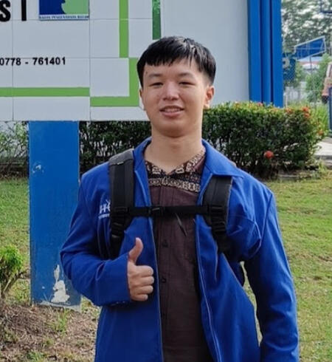
About Me
Name : Khenjy Johnelson
Age : 20
Semester : IV
University : Universitas Universal

Slide 5
What will be discussed
Overview
Omnitags
Demo
Explanation
Extras
Closing

Slide 6
Timeline: The background
DEC 2023
Got the idea
JAN 2024
Interview with Sir Yodi
About is my app implement OOP yet?
Feedback: Good for small scale, not for big scale

Slide 7
Timeline: The discovery
MAR 2024
APR 2024
Hotel Project continues…
FEB 2024
Got into library project as a website tester
Introduced into POSTMAN
Technique research continues…
First time found the technique (I named it Omnitags)
Feature expansion

Slide 8
Timeline: The results
MAY 2024
Hosted the website hotelkhenjy.com
JUN 2024
Data validation
Better UI
Future
Implementation on other frameworks

Slide 9
Overview

Slide 10
Most programming techniques
Database field variables are inputed manually
So many variant of variables
Unit testing is kinda slow and manual on initiation
So many debugging to do

Slide 11
Programmers are not just keyboard typers
Programmer is a problem solver

Slide 12
OMNITAGS
Omni = multiple use
Tags = field

Slide 13
How I found this technique
March – April 2024

Slide 14
Does this fix AGILE
March – April 2024

Slide 15
The thing about the technique
It’s not found On (PER June 2024):
Forum
Documentations
Youtube videos
Chatgpt (it even calls it unorthodox)

Slide 16
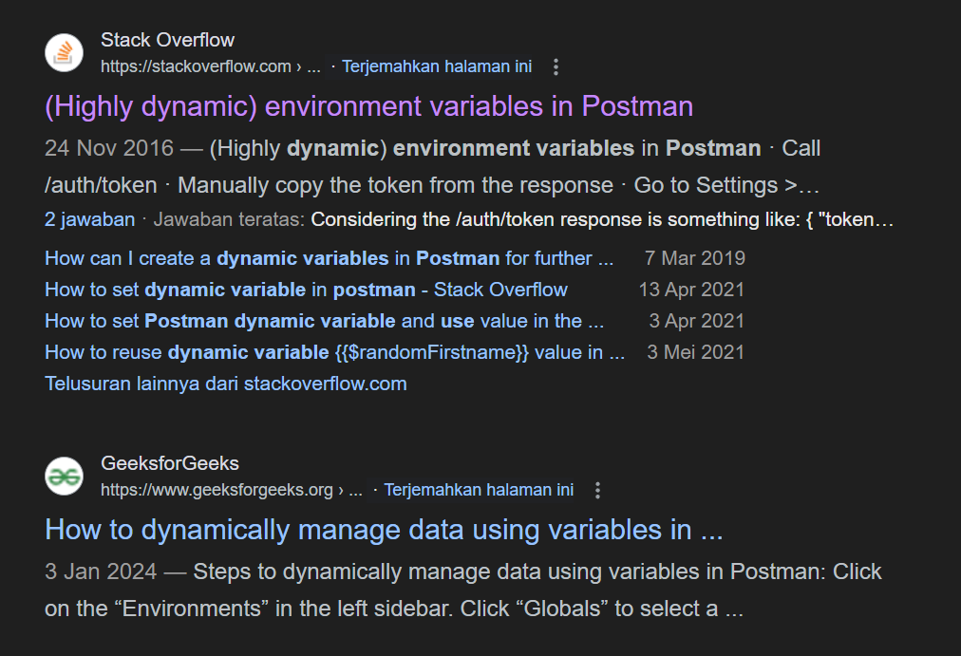
MOST SEARCHES AT THIS TIME
How to use
HOW TO CREATE ENVIRONMENT VARIABLES

Slide 17
Omnitags
Encapsulation is key
The keys can be modified (total control)
Can be combined with routes
Input once, mvc done
Less Hardcode, More Softcode
More agile

Slide 18
What Omnitags does
Make project initiation by estimation from 5 to 10 times faster
Encouraging a lot of Agility in SDLC (Software Development Life Cycle)
More problem solving than finding the problem itself
Making variables names more consistent
Making app could scale up and down as needed

Slide 19
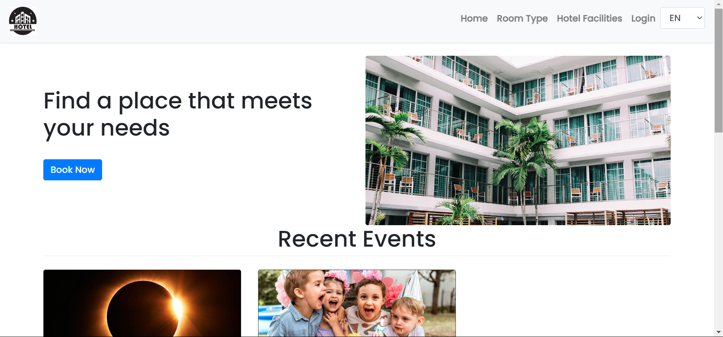
About hotelkhenjy.com
Started as a project for Semester 3 PWEB
Turned into a research project for backend
Visit on hotelkhenjy.com
Made using Codeigniter 3 and MySQL

Slide 20
DEMO
VSCODE + WEBSITE + PHPMYADMIN + postman

Slide 21
EXPLANATION
HOW OMNITAGS EVEN WORK?

Slide 23
Acknowledgements
Yodi. S.Kom., M.S.I
For initiating the library project
Ehren Visteano
For inviting me to join the library project
Williams
For teaching me how to use POSTMAN
Yuriko, Erwin, and other teammates
For supporting me during the library project
ChatGPT
For making this research possible

Slide 24
References
https://techcrunch.com/2021/08/18/api-platform-postman-valued-at-5-6-billion-in-225-million-fundraise/
https://codeigniter.com/userguide3/general/welcome.html

Slide 25
Programming is a skill best acquired by practice and example rather than books
Alan Turing

Slide 26
Thank You
khenjyjohnelson123@uvers.ac.id

